Slide 1
Introduction to Linux
Exploring the Foundation of Open Source Operating Systems

Slide 2
What is Linux?
Linux is an open-source and Unix*-like operating system.
Created by Linus Torvalds in 1991.
Used in diverse fields: Servers, desktops, embedded systems, and more.
Key Point: Linux powers over 90% of servers on the internet. *UNIX is a multi-user, multitasking operating system (OS) that was developed in the late 1960s by Bell Laboratories at AT&T

Slide 3
Brief History of Linux
Unix (1969): Inspiration for Linux.
GNU Project (1983): Free software foundation started by Richard Stallman.
1991: Linus Torvalds announced Linux Kernel.
Open Source Revolution: Collaboration among developers worldwide.

Slide 4
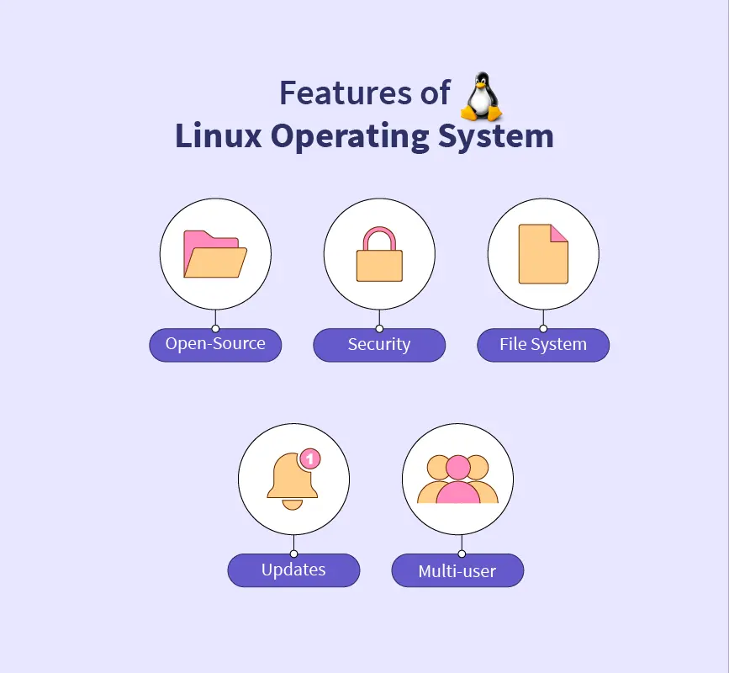
Core Features of Linux
Open Source: Freely available and customizable.
Multiuser Support: Many users can work simultaneously.
Portability: Runs on a wide range of hardware.
Security: Built-in user and process isolation.
Stability: Reliable for long-term use.

Slide 5
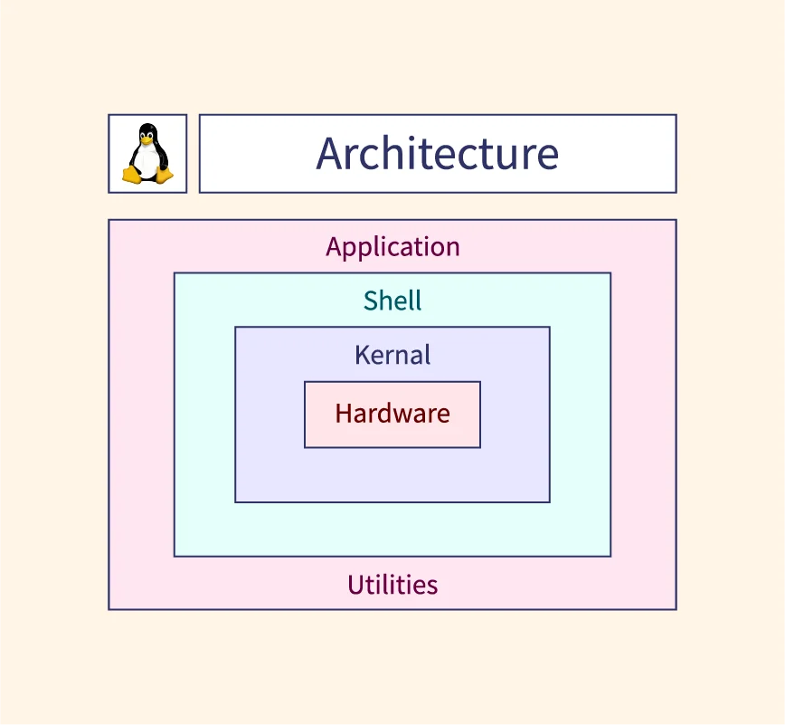
Linux Architecture
Hardware: Physical components of the computer.
Kernel: The core that interacts with hardware.
System Libraries: Provide essential functionality.
Shell: Command-line interface for user interaction.
Applications: Software running on top of the OS.

Slide 6
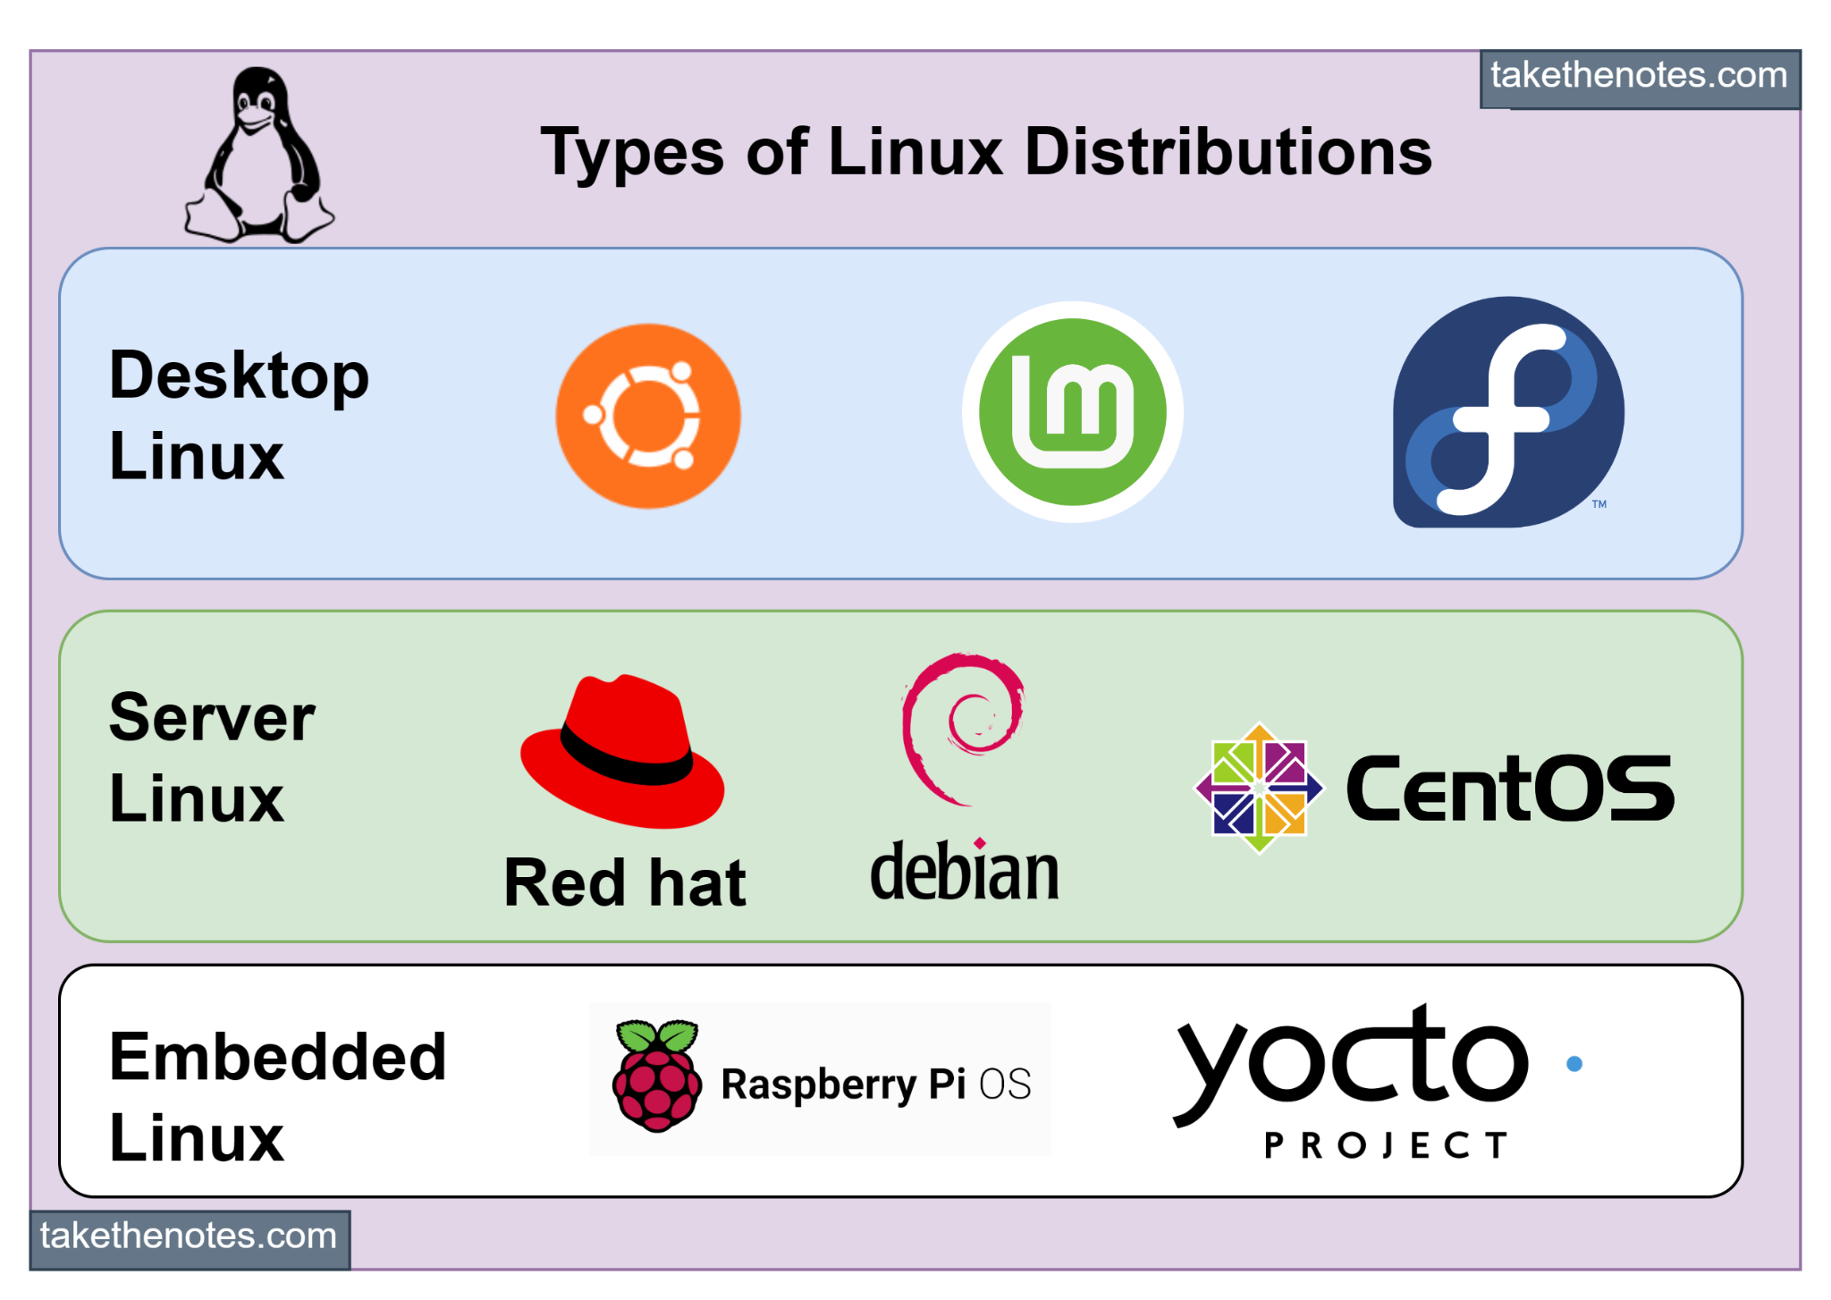
Linux Distributions
What is a Distribution?
A collection of the Linux kernel, software packages, and tools.
Popular Distributions:
Ubuntu: User-friendly.
Fedora: Cutting-edge software.
Debian: Stability and reliability.
Arch Linux: Customizable and minimalistic.
Specialized lightweight distros:
Tiny Core Linux (~16 MB)
Puppy Linux (~300 MB)

Slide 7
Why Choose Lightweight Linux Distros?
Designed for systems with low RAM and storage.
Suitable for:
Old computers
Embedded systems
Minimalistic environments
Examples:
Tiny Core Linux: ~16 MB
Damn Small Linux: ~50 MB
AntiX: ~400 MB
Bodhi Linux: ~700 MB

Slide 8
Basic Linux Commands
Navigating the File System:
ls: List files.
cd: Change directory.
pwd: Print working directory.
File Management:
mkdir: Create a directory.
rm: Remove a file or directory.
cp: Copy files.
System Monitoring:
top: View running processes.
df -h: Check disk usage.
free -m: Check memory usage.

Slide 9
Real-World Applications of Linux
Web Servers: Powering Google, Facebook, and Twitter.
Supercomputers: Runs on 100% of the world’s top 500 supercomputers.
IoT Devices: Used in smart devices and embedded systems.
Programming: Preferred platform for developers due to robust tools.
Gaming: Platforms like SteamOS bring gaming to Linux.

Slide 10
Linux Desktop Environments
GNOME: Modern and simple.
KDE Plasma: Highly customizable.
XFCE: Lightweight and fast.
LXQt: Minimal resource usage.
Mate: Traditional desktop feel.

Slide 11
Myths and Misconceptions
"Linux is hard to use" → Modern distros are beginner-friendly.
"No software is available" → Vast libraries of applications.
"Only experts use Linux" → Distros like Ubuntu and Linux Mint are for everyone.

Slide 12
Advantages of Linux
Cost: Free to use.
Customizability: Tailor it to your needs.
Performance: Runs efficiently on all hardware.
Security: Resilient against malware and viruses.
Community: Active global support.

Slide 13
Challenges of Linux
Learning curve for beginners.
Software compatibility: Some proprietary software may not run.
Hardware drivers: Rare cases of unsupported hardware.

Slide 14
Conclusion
Linux is a versatile, secure, and open-source OS.
Powers much of today’s technology and infrastructure.
Encouragement: Start small, experiment with a lightweight distro.
“The Linux community is always there to support you.”

